Slide 1
UVa 10668 Expanding Rods

Slide 2
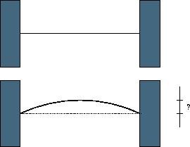
UVa 10668 Expanding Rods (Time Limit: 3 seconds)
Input:
the initial length of the rod (L),
the temperature change (C),
the coefficient of heat expansion of the material (n)
After the rod is heated, its new length L’ becomes (1+n*C)*L.
h
Output: The displacement(h) of the rod center after the rod is heated

Slide 3
Sample Input
Sample Output
1000 100 0.0001
15000 10 0.00006
10 0 0.001
-1 -1 -1
L (原始長度), C (溫度變化), n (擴張係數)
61.329
225.020
0.000
End of input
Height
After the rod is heated, its new length L’ becomes (1+n*C)*L.

Slide 4
Solution
Bisection Method (二分法)
Two Solutions:
By Bisecting Height h
By Bisecting Radius r

Slide 5
問題:
給定L, C, n之後, 沒有公式可以直接算出高度h
解法: 只有用二分法把高度h逼出來

Slide 6

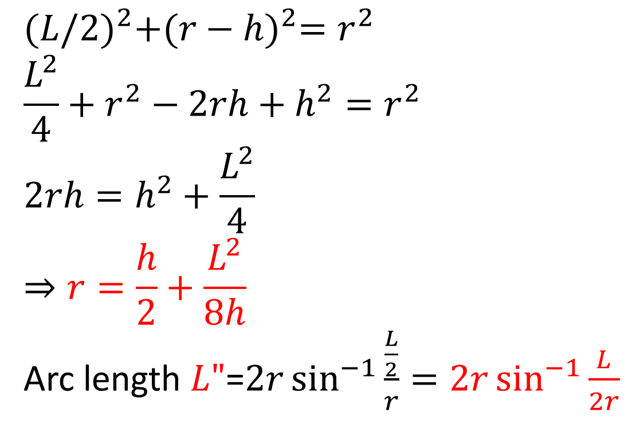
UVa 10668 Expanding Rods
L”
h
L/2
L/2
$${(L/2)}^{2}+{(r−h)}^{2}=r^{2}$$
$$\frac{L^{2}}{4}+r^{2}−2rh+h^{2}=r^{2}$$
$$2rh=h^{2}+\frac{L^{2}}{4}$$
$$⇒r=\frac{h}{2}+\frac{L^{2}}{8h}$$
Arc length $L"$=$2r\sin^{−1}{\frac{\frac{L}{2}}{r}=2r\sin^{−1}{\frac{L}{2r}}}$
r-h
r
$$θ/2$$
Two Solutions:
By Bisecting Height h
By Bisecting Radius r

Slide 7
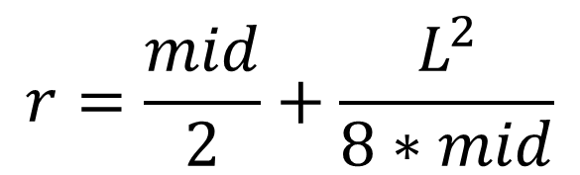
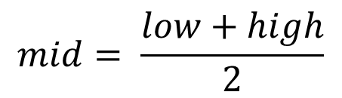
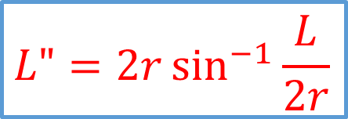
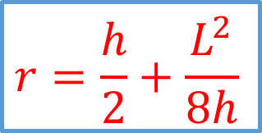
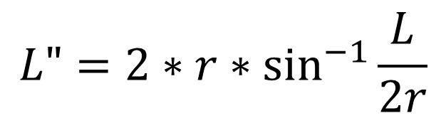
UVa 10668 Expanding Rods
Solution 1
Height h Finding (Bisection Method: bisecting h)
$$mid= \frac{low+high}{2}$$
low
high
Height
0
$$r=\frac{mid}{2}+\frac{L^{2}}{8∗mid}$$
L/2
$$r=\frac{h}{2}+\frac{L^{2}}{8h}$$
$$L"{=2∗r∗\sin^{−1}{\frac{L}{2r}}}$$
$$L"{=2r\sin^{−1}{\frac{L}{2r}}}$$
L’=(1+n*C)*L
If (L”-L’) > 1.0e-10, then
low
high ← mid

Slide 8
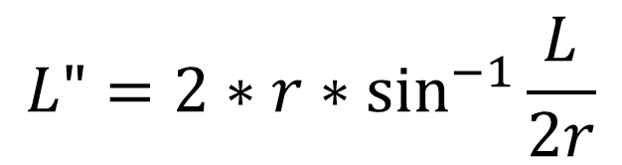
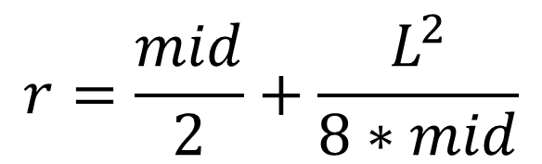
UVa 10668 Expanding Rods
Solution 1
Height h Finding (Bisection Method: bisecting h)
$$mid= \frac{low+high}{2}$$
low
high
Height
0
L/2
$$r=\frac{mid}{2}+\frac{L^{2}}{8∗mid}$$
$$r=\frac{h}{2}+\frac{L^{2}}{8h}$$
$$L"{=2∗r∗\sin^{−1}{\frac{L}{2r}}}$$
$$L"{=2r\sin^{−1}{\frac{L}{2r}}}$$
L’=(1+n*C)*L
If (L”-L’) < 1.0e-10, then
low ← mid
high

Slide 9

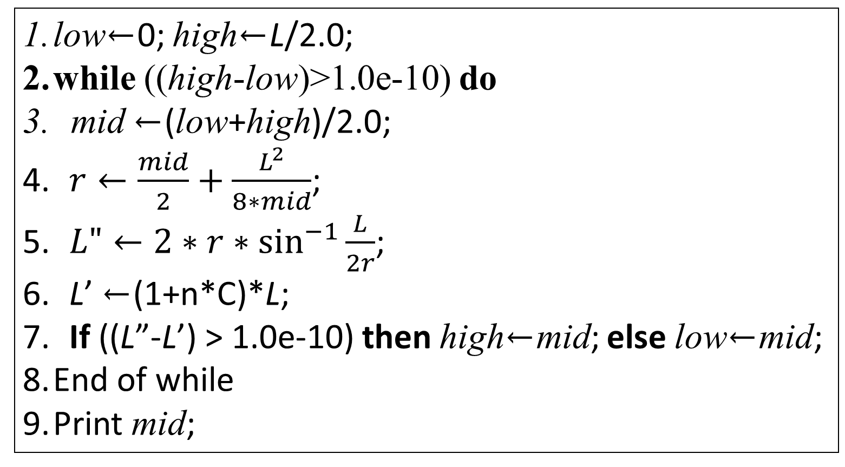

UVa 10668 Expanding Rods
Solution 1
Solution: by Bisecting h
low←0; high←L/2.0;
while ((high-low)>1.0e-10) do
mid ←(low+high)/2.0;
$r←\frac{mid}{2}+\frac{L^{2}}{8∗mid}$;
$L"{←2∗r∗\sin^{−1}{\frac{L}{2r}}}$;
L’ ←(1+n*C)*L;
If ((L”-L’) > 1.0e-10) then high←mid; else low←mid;
End of while
Print mid;
$$r=\frac{h}{2}+\frac{L^{2}}{8h}$$
$$L"{=2r\sin^{−1}{\frac{L}{2r}}}$$

Slide 10

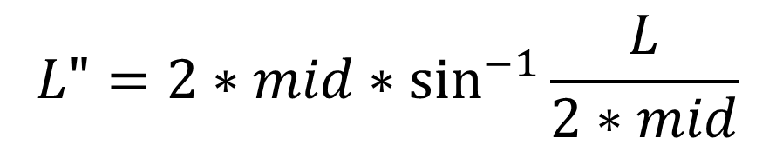
UVa 10668 Expanding Rods
Solution 2
Radius r Finding (Bisection Method: bisecting r)
$$mid= \frac{low+high}{2}$$
low
high
Radius
L/2
∞
$$L"{=2∗mid∗\sin^{−1}{\frac{L}{2∗mid}}}$$
L’=(1+n*C)*L
If (L”-L’) < 1.0e-10, then
$$L"{=2r\sin^{−1}{\frac{L}{2r}}}$$
low
high ← mid

Slide 11
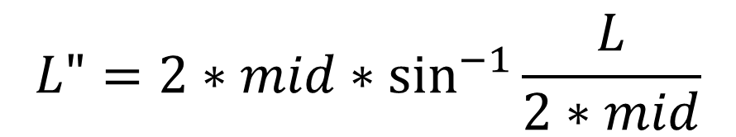
UVa 10668 Expanding Rods
Solution 2
Radius r Finding (Bisection Method: bisecting r)
$$mid= \frac{low+high}{2}$$
low
high
Radius
L/2
∞
$$L"{=2∗mid∗\sin^{−1}{\frac{L}{2∗mid}}}$$
L’=(1+n*C)*L
If (L”-L’) > 1.0e-10, then
$$L"{=2r\sin^{−1}{\frac{L}{2r}}}$$
low ← mid
high

Slide 12

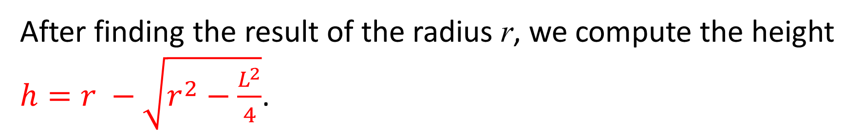
UVa 10668 Expanding Rods
Solution 2
Solution: by Bisecting Radius r
After finding the result of the radius r, we compute the height $h=r −\sqrt{r^{2}−\frac{L^{2}}{4}}$.
h
L/2
$$\sqrt{r^{2}−\frac{L^{2}}{4}}$$
r
r

Slide 13

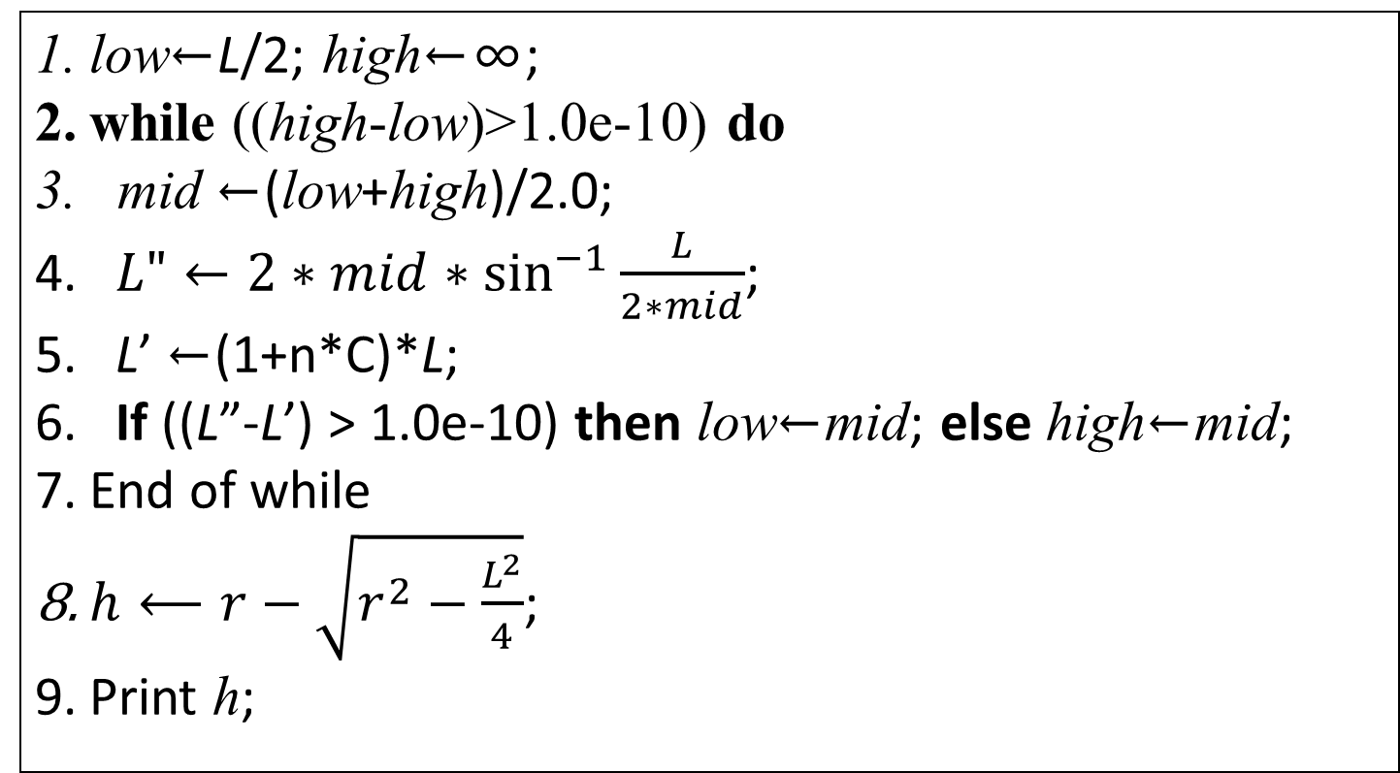

UVa 10668 Expanding Rods
Solution 2
Solution: by Bisecting Radius r
low←L/2; high←∞;
while ((high-low)>1.0e-10) do
mid ←(low+high)/2.0;
$L"{←2∗mid∗\sin^{−1}{\frac{L}{2∗mid}}}$;
L’ ←(1+n*C)*L;
If ((L”-L’) > 1.0e-10) then low←mid; else high←mid;
End of while
$h⟵r−\sqrt{r^{2}−\frac{L^{2}}{4}}$;
Print h;
$$L"{=2r\sin^{−1}{\frac{L}{2r}}}$$
$$h=r −\sqrt{r^{2}−\frac{L^{2}}{4}}$$

